Slide 1
-CHAPTER THREE-
ONE DIMENSIONAL STEADY STATE HEAT CONDUCTION

Slide 2
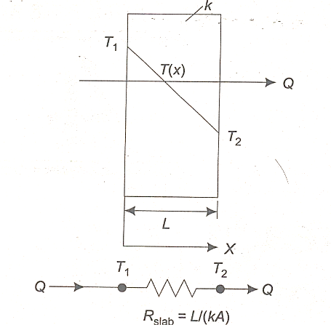
Plane Slab
The governing equation for a plane slab with One-dimensional, steady state heat conduction, with no internal heat generation is:
$$\frac{∂^{2}T}{{∂x}^{2}}=0…………………1$$
Integrating Eq.1 once:
$$\frac{∂^{ }T}{{∂x}^{ }}=C_{1}$$
Integrating again:
$$T\left(x\right)=C_{1}x+C_{2}…………….2$$
B.C.(i): $T=T_{1 }at x=0$
B.C.(ii): $T=T_{2 }at x=L$
$$T\left(x\right)=\frac{\left(T_{2}−T_{1}\right)}{L}x+T_{1}………………3$$

Slide 3
To find the heat flux, apply Fourier law,
$$q=−k\frac{dT}{dx}$$
$$\frac{dT}{dx}=C_{1}={(T_{2}−T_{1})}/L$$
So:
$$q=−k\frac{\left(T_{2}−T_{1}\right)}{L}=k\frac{\left(T_{1}−T_{2}\right)}{L} W/{m^{2}}…………..5$$
The heat flow rate is
$$Q=qA=−kA\frac{\left(T_{2}−T_{1}\right)}{L} W…………..6$$

Slide 4
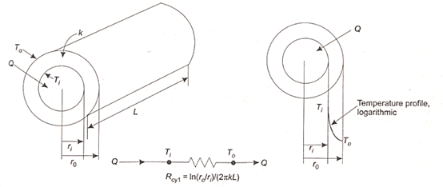
2.2 Cylindrical Systems
The governing equation for the Cylindrical systems, One-dimensional, steady state heat conduction, with no internal heat generation is:
$$\frac{1}{r}\left(\frac{∂T}{∂r}\right)+\frac{∂^{2}T}{∂r^{2}}=0$$
$$T\left(r\right)=C_{1}\ln\left(r\right)+C_{2}……….a$$
$$at r=r_{i} T=T_{i}$$
$$at r=r_{o} T=T_{0}$$
$$\frac{T\left(r\right)−T_{i}}{T_{o}−T_{i}}=\frac{\ln\left(\frac{r_{ }}{r_{i}}\right)}{\ln\left(\frac{ r_{o}}{r_{i}}\right)}$$
$$Q=k2πL\frac{T_{i}−T_{o}}{\ln\left(\frac{ r_{o}}{r_{i}}\right)}……..d$$

Slide 5
Spherical Systems
$$\frac{∂^{2}T}{{∂r}^{2}}+\frac{2}{r}\frac{∂T}{∂r}=0$$
$$\frac{T\left(r\right)−T_{i}}{T_{o}−T_{i}}=\frac{\frac{1}{r_{ }}−\frac{1}{r_{i}}}{\frac{1}{{r_{o}}_{ }}−\frac{1}{r_{i}}}=\frac{ r_{o}}{r_{ }}∗\left(\frac{r−r_{i}}{r_{o}−r_{i}}\right)$$
The heat transfer rate equation is:
$$Q=\frac{∆T}{R_{sph}}=\frac{T_{i}−T_{o}}{\frac{r_{o}−r_{i}}{4πkr_{o}r_{i}}}$$

